Slide 1
How to Use this PPTX template
This PowerPoint is a template you can use/share to onboard your team to Qlik Cloud.
  Template is co-branded to add your specific organization’s name and logos.
  {Braces} indicates text that requires personalization, feel free to change titles, images, even videos to be unique to your tenant.
Watch the video overview for System Admins and Service Account Owners showing how to use this template.
  In the notes section below each slide there is some usage guidance.
  This provides recommended resources curated by Qlik to get your end-users started.

Slide 2
{Title - Onboarding to Qlik Cloud}
&
{Your Logo Here}
Qlik Cloud & {Company Name/Team Name}
{Name}
{Job Title}
{Month XX, 2023}

Slide 3
Why Qlik?
Login & Access
Navigating the Qlik Cloud Hub
Applications by Group/Team
Navigating Applications
Request Data & Access
Useful Features
Additional Resources for Adoption
Feedback Loop
Agenda

Slide 4
Why Qlik?

Slide 5
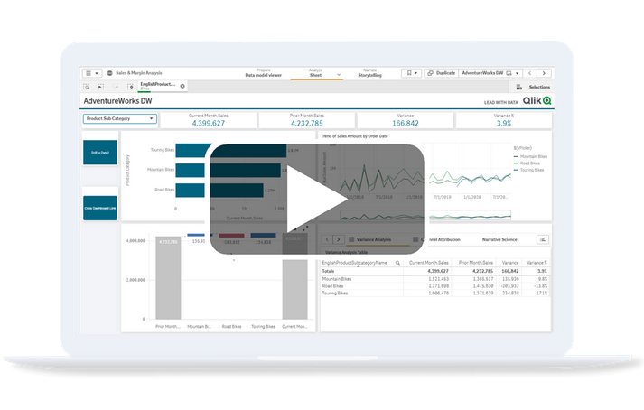
Why Qlik?
What’s in it for you and {Organization}?
Freely explore all the data you need, to make new discoveries that you can action quickly.
Do More, with key features like bookmarks, scheduled reports and collaboration functionality.
Take it on the road: Bring the information with you wherever you go with the Qlik mobile app
https://learning.qlik.com/pluginfile.php/168830/mod_resource/content/4/Insights_Finance/Insights_Finance.html
Level up your Reporting Strategies
Notes:
This is meant for your organization to understand their expectations and use case for the Qlik tool. Every organization’s goals are unique, so personalize this as you see fit! We provided some of the reasons we think Qlik is awesome, feel free to use these to get the ball rolling!

Slide 6
Why Qlik?
{Organization}’s expected value
From
{Previous Data Analytic Tools and their pain-points}
To
Qlik’s associative engine and active intelligence.
Why {Organization} is choosing to Qlik:
{Insert the key benefits and specific use cases that you hope your end users will get from Qlik}
Notes:
To make it easier for your organization to get started, we recommend uploading your tenant’s link or app to whatever internal management system you have. Whether that be an intranet home page, Okta app, or SharePoint, its always easiest to have a home base to point users to. (Also a great place for feedback….)

Slide 7
Login & Access

Slide 8
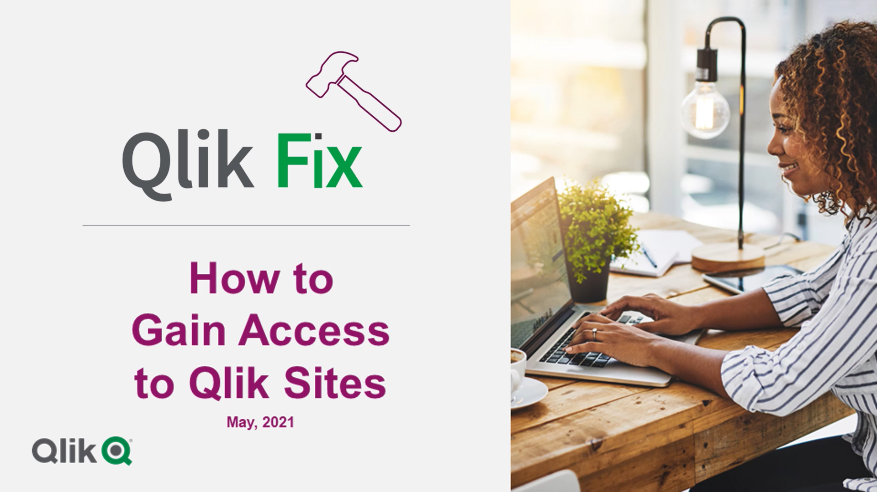
Create a Qlik ID
How to Register for a Qlik Account
Your Qlik ID is used to login to all Qlik portals such as the Qlik Community, the Qlik Learning Portal, {and the Qlik Cloud environment, if a Custom Identity Provider isn’t configured}
Notes:
Notes for Admin:
Users will login with their own credentials if a custom IDP was configured, or a Qlik ID if otherwise.
We recommend all users create a Qlik ID, regardless of custom tenant, so they can access Qlik Learning and Qlik Community for their data development journey.

Slide 9
Logging in to Qlik Cloud
{tenantname.region.qlikcloud.com}
{Add a Picture of your Qlik Cloud Hub}
Qlik Cloud is the platform where you can access all Qlik Services such as Qlik Sense. This is our Cloud Analytics service where you can easily explore your data and quickly gain insights.
{This box should include instructions on how to login to your Qlik Cloud tenant}
      {You should include log-in credentials information like username type (firstname.lastname@company.com or domain\userid)}
If you need help with the set-up, please reach out to {your tenant admin}.
Notes:
Notes for Admin:
These instructions are assuming Users have been created in your tenant and already given access.
Users will login with their own credentials if a custom IDP was configured, or a Qlik ID if otherwise.
To make it easier for your users, we suggest creating a space for Qlik in your internal administrative tools. Have Okta? Make Qlik an App. Confluence or SharePoint? Have an easy to find page/site with the link that’ll take you right to the tenant. These places can also serve as a great intake tool for questions or feedback internally.

Slide 10
Navigating Qlik Cloud Hub

Slide 11
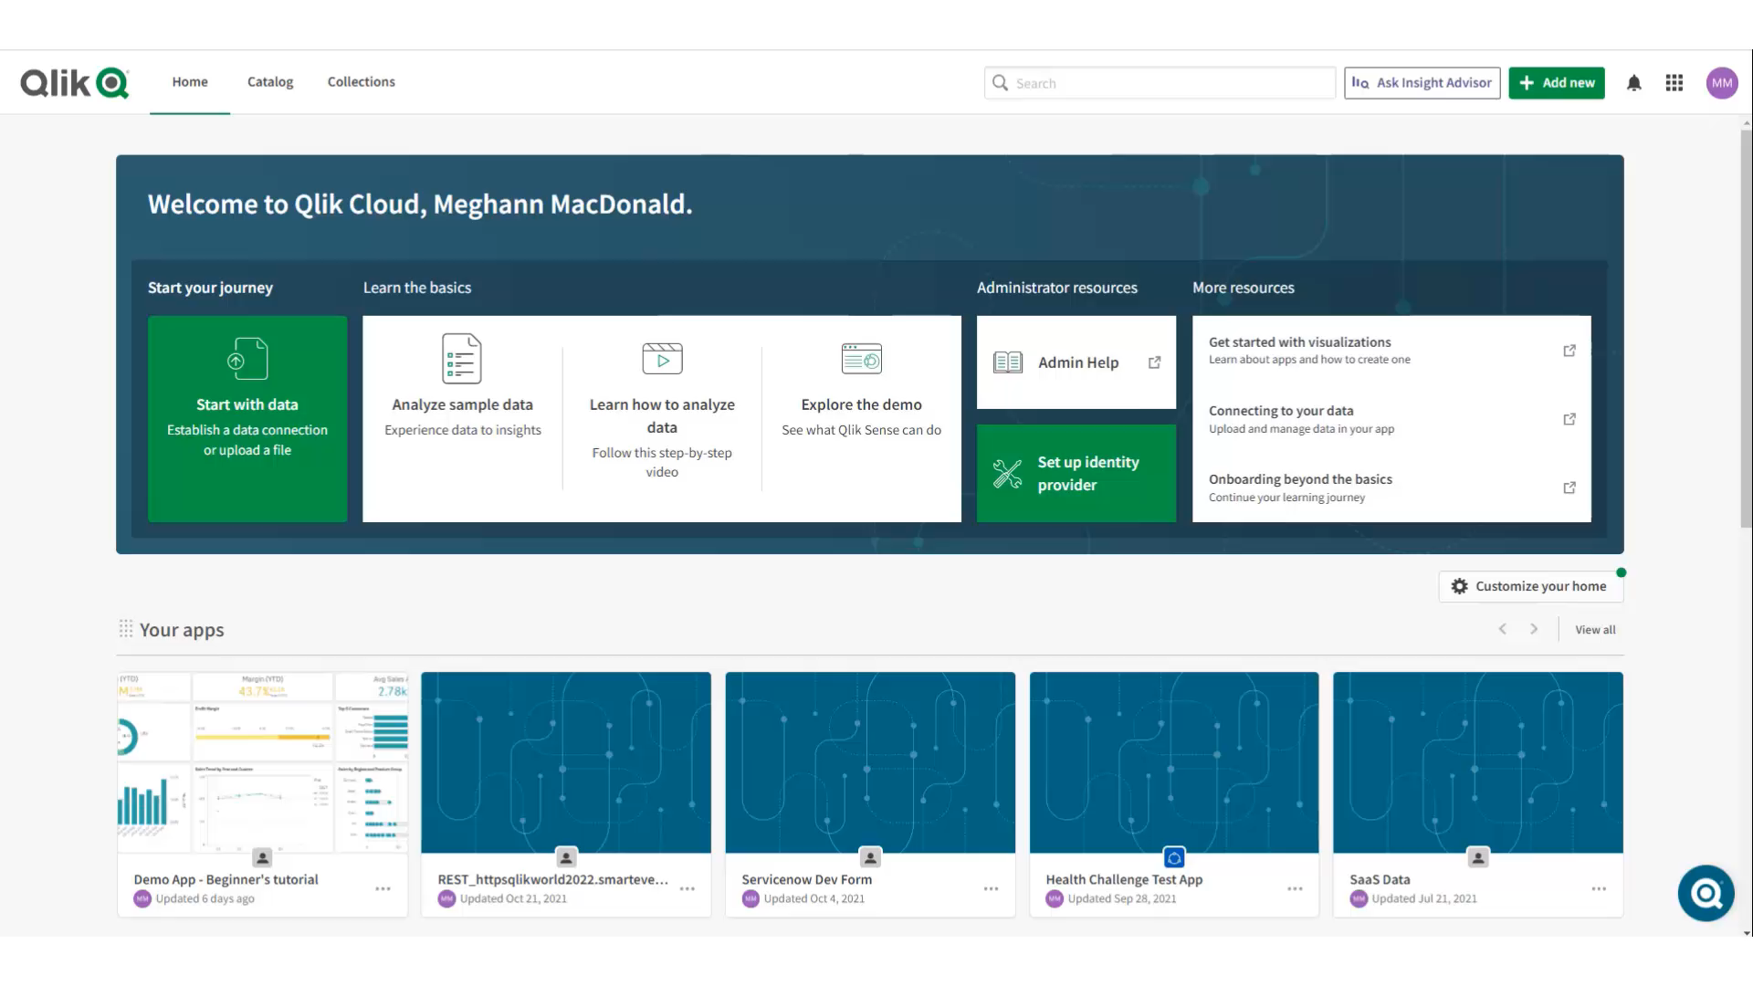
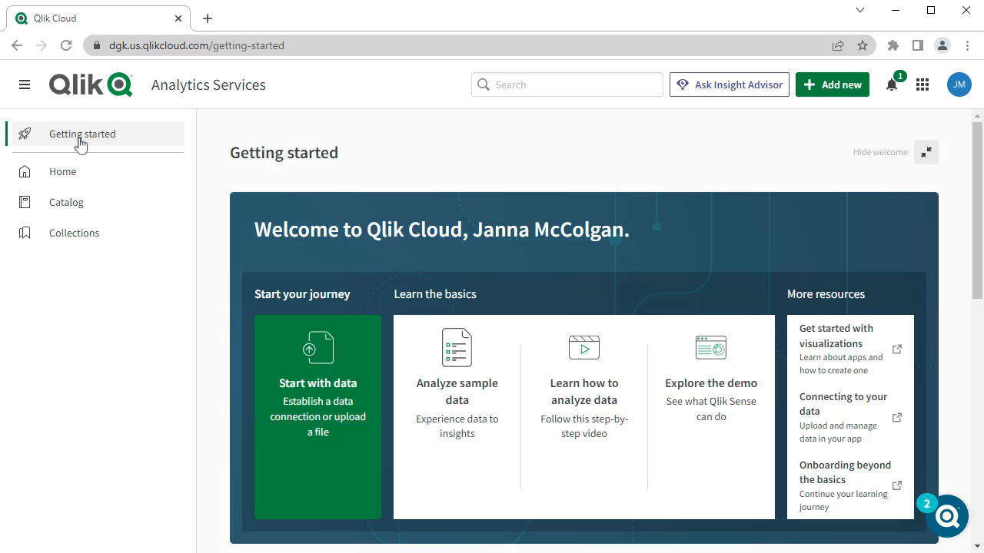
Navigating Qlik Cloud Hub
Tour the Tool
{Add a Picture of your Qlik Cloud Hub}
Getting Started with Qlik Cloud
Notes:
Notes for Admin:
Professional and Analyzer licenses may have different experiences with viewing available features in their Qlik Cloud Hubs.
This is our standard view of the Qlik Cloud Hub, but every organization has some level of personalization. We recommend you pre-record Demos/Tours of your own tenant to get them most familiar with the interface or use this time in your presentation to jump to it live.

Slide 12
Applications and Spaces by Group

Slide 13
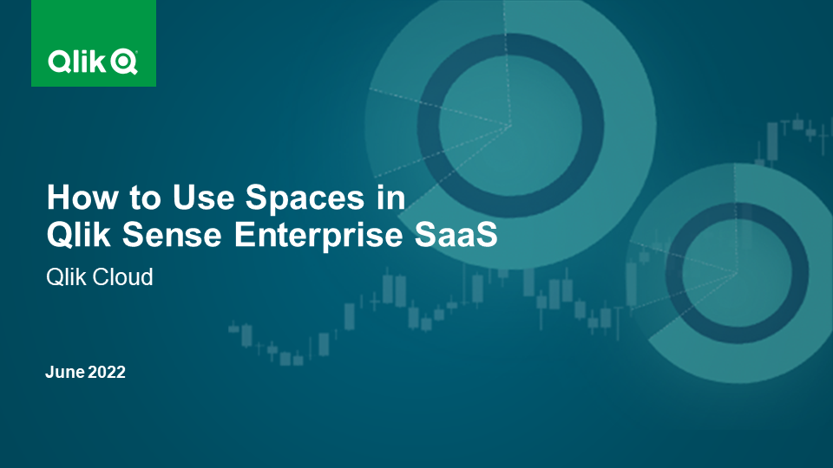
Applications and Spaces by Group
    {Let organization know which groups have been invited to which spaces}
    {List out any apps already developed and their purpose per group/work function}
      {Share Examples via demonstration}
Space
App
Sheet
Working in Spaces

Slide 14
Exploring Applications

Slide 15
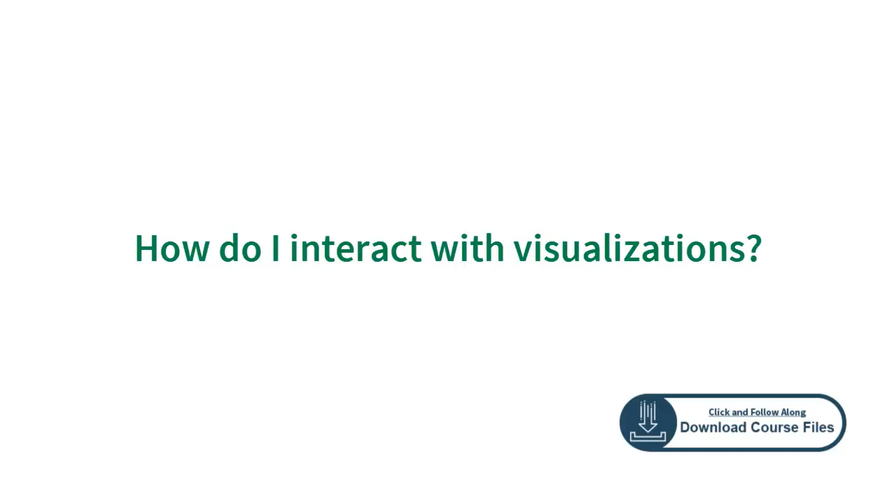
Exploring Apps
    Searching/Selecting
      How Do I Interact with Visualizations?
      How Do I Analyze Visualizations?
    Consuming
      Why analytics?
      Introduction to data informed decision making
    Collaborating
      Download Visualizations and Data
      Grant Access to sheets bookmarks
      How do I collaborate with notes in Qlik Cloud?
    Stories
      How do I create a data story?
Interacting with Visualizations
Notes:
Notes for Admin:
This section pairs tool navigation with data literacy principles.
Encourage your users to explore the learning modules linked, after sharing the embedded video which gives a high level navigation tutorial.

Slide 16
Establishing a New Data Connection

Slide 17
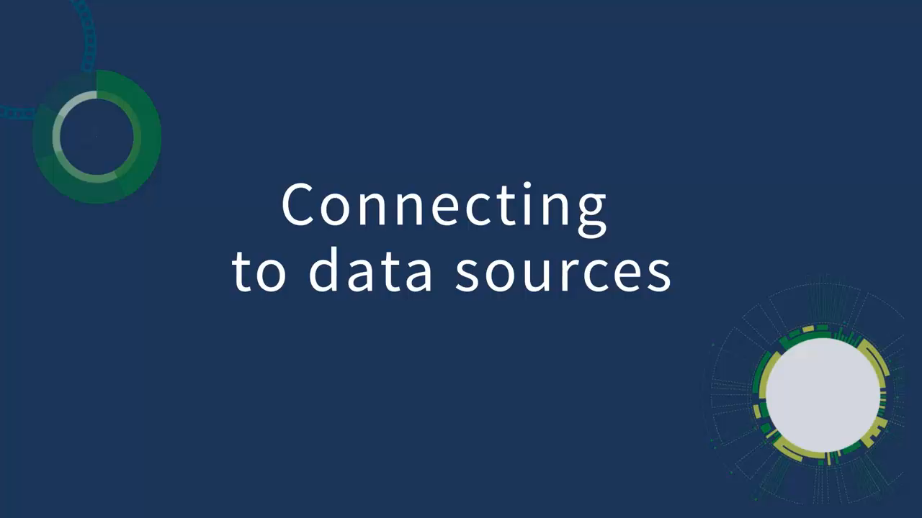
Accessing Data
  More source types are shared through this playlist.
  {If access is restricted within your tenant, share your internal process here for users to request further access from a tenant admin for specific data sources or managed spaces.}
Connecting to Your Data

Slide 18
Useful Features

Slide 19
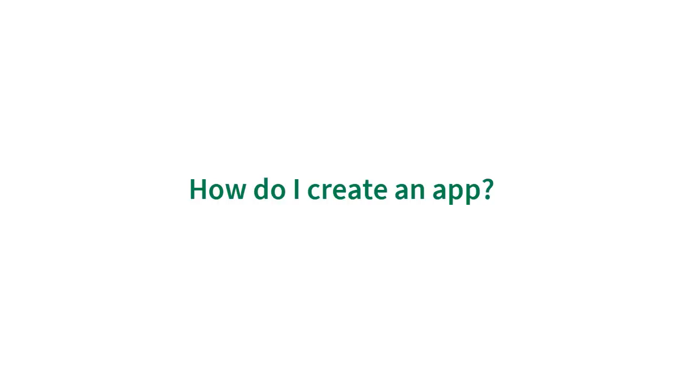
Useful Features
    Create a new app
How do I create an app?
TBD
Notes:
Notes for Admin:
This is useful for Professional Licenses only.
This is how they can start creating value, playing with visualizations and developing reports.

Slide 20
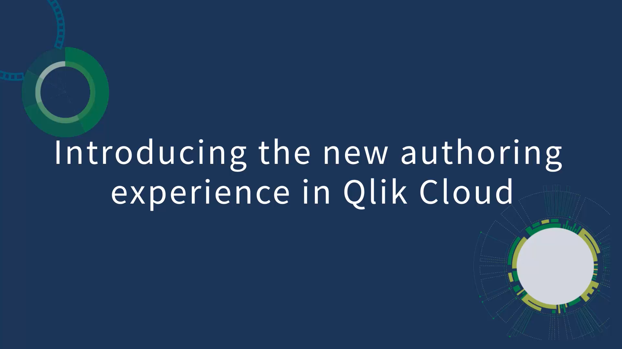
Useful Features
    Simplified Authoring Experience
TBD
Authoring Experience
Notes:
Notes for Admin:
This is useful for Professional Licenses only.
This is how they can start creating value, playing with visualizations and developing reports.

Slide 21
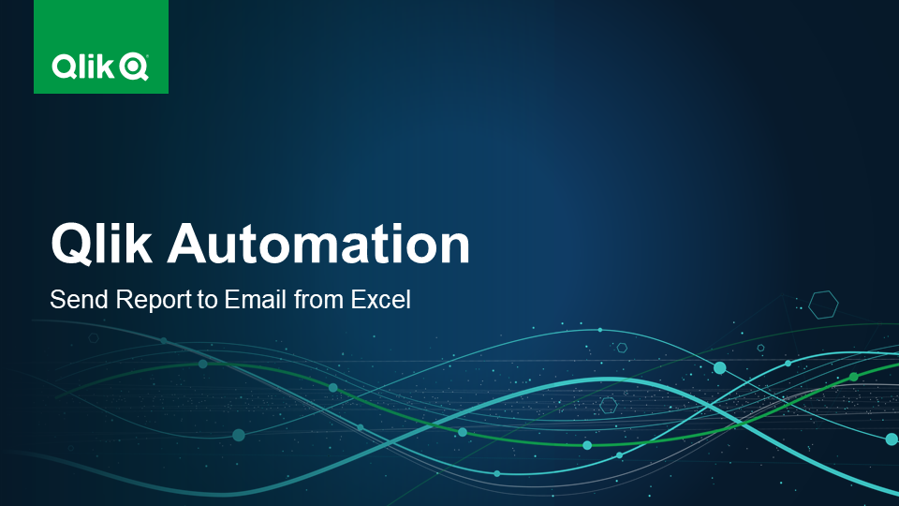
Useful Features
    Using Qlik Application Automation
    Creating a Qlik Reporting Service report
Using Qlik Automation
TBD
Notes:
Notes for Admin:
This is useful for Professional Licenses only.
This is how they can start creating value, playing with visualizations and developing reports.

Slide 22
Additional Resources

Slide 23



Discover
A connected network made up of every user and Qlik fan! Ask questions, master solutions, and collaborate world-wide.
Learning Paths
Join a multitude of live and on demand webinars to get your data muscles moving with our Qlik experts.
Intro to Qlik Resources
Qlik Community
Events and Webinars
Qlik Continuous Classroom has a variety of self-paced courses addressing a range of topics from visualizations to installation.
So many new places to explore! Don’t worry, we have you covered. This webinar is your tour guide through the ecosystem of Qlik.

Slide 24
Feedback

Slide 25
Where do I go to submit feedback?
Questions
Access Requests
Feature Requests
Roadblocks
Data Load needs
Office Hours:
{Reoccurring date/times}
Internal Site:
{Intranet Page/SharePoint/App/etc.}
Contact Information:
{Admin Emails}
Feedback Loop
Notes:
Ensure your organization has its own Qlik Cloud feedback loop! Are additional apps or spaces needed? Access requests? Do your users need help recreating their manual reports in Qlik’s automated engine?
The onboarding doesn’t end after this enablement session! Host office hours as your organization gets acclimated. We recommend creating a survey for this enablement presentation, any additional training, or the current apps in flight.
Most importantly, it’s a best practice to have a virtual location your users can go to for feedback, news on updates made to your tenant, and easily navigate to Qlik Cloud! This can be an intranet page, SharePoint or Confluence sites, Okta app, etc.! Whatever works best for you and your organization to use at scale ☺

Slide 26
{email address}

